Slide 1
Capstone Final Project
Presented By-Anjnesh vasudeva

Slide 2
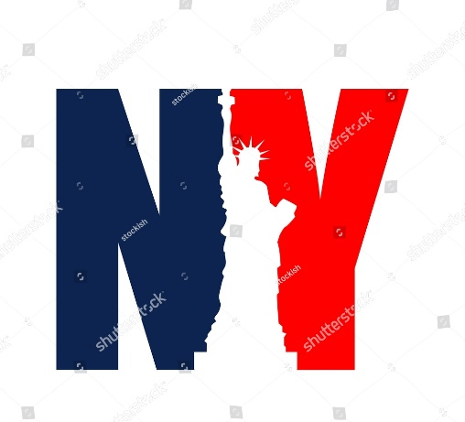
Introduction
This project mainly focuses on the people of the new York. In which through research we will find the most visited commercial shops depending on the number of check-in it will receive. Then we are going to analyse the neighbour hood to look that some of the places are lacking particular type of shop which may have higher potential business opportunity.

Slide 3



Target audience
The people who are interested in opening a shop but have no idea what kind and in which area should they open the shop.

Slide 4

Data section
The data contains two files in TSV format. Each file contain 8 columns
User id
Venue id
Venue category id
Venue category name
Latitude
Longitude
Time zone offset in minutes
UTC time

Slide 5
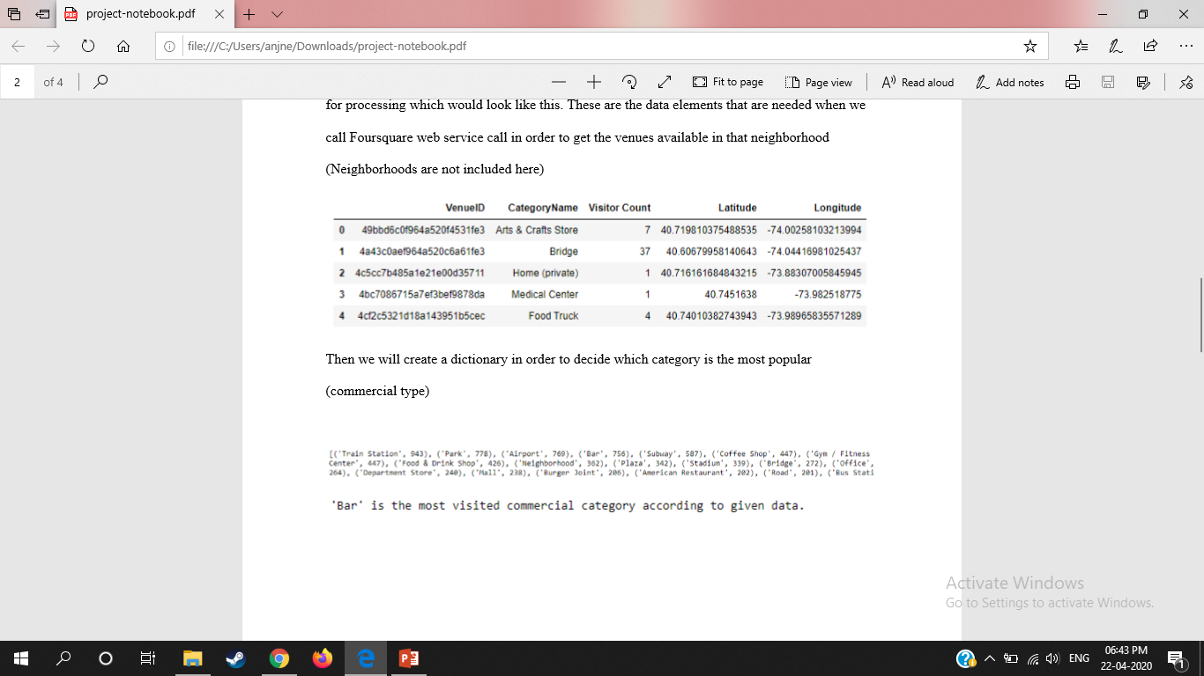
Extraction of the data
Bar is the most visited commercial category according to the given data.

Slide 6
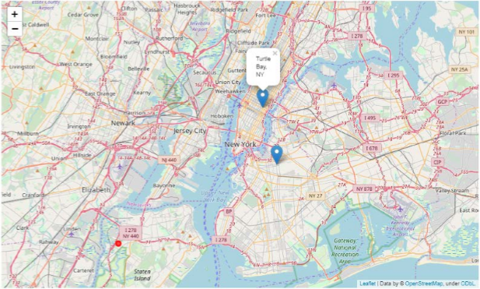
Bedford-Stuyvesant, turtle bay
Red dot is the centre

Slide 7

Result and conclusion
In our sample of 2000 venues, we did find more than 10 coordinates that has no Bar (the most visited shop type according to sample) within four-kilometer sphere. And we did manage to get the neighborhoods’ names from foursquare database and pin down the two closest neighborhoods, ‘Bedford-Stuyvesant’, and ‘Turtle Bay’, into the map. Of course, it should not be forgotten that the data used above is almost 6-year old so further research might be needed.
Anyways, the results according to the data in hand can be checked from the map and analysis above can be of use for future entrepreneurs.

